Slide 1
Google Data Analytics – Capstone Project
Cyclistic – Jesslyn Jane

Slide 2
Introduction
I am wearing the hat of a junior data analyst, working in the marketing analyst team at Cyclistic, a bike-share company in Chicago. Cyclistic is a bike-share program that features more than 5,800 bicycles and 600 docking stations. Cyclistic sets itself apart by also offering reclining bikes, hand tricycles, and cargo bikes, making bike-share more inclusive to people with disabilities and riders who can’t use a standard two-wheeled bike. The majority of riders opt for traditional bikes; about 8% of riders use the assistive options. Cyclistic users are more likely to ride for leisure, but about 30% use them to commute to work each day. Customers who purchase single-ride or full-day passes are referred to as casual riders. Customers who purchase annual memberships are Cyclistic members.
The director of marketing believes the company’s future success depends on maximizing the number of annual memberships. Therefore,my team wants to understand how casual riders and annual members use Cyclistic bikes differently. From these insights, my team will design a new marketing strategy to convert casual riders into annual members. But first, Cyclistic executives must approve the recommendations, so they must be backed up with compelling data insights and professional data visualizations.

Slide 3
Method Approach
In this project, I will use 6 steps to ensure its completion:
Ask
Prepare
Process
Analyze
Share
Act

Slide 4
Step 1. Ask
Business task: The different of annual members and casual riders in using Cyclistic bikes hourly, daily, and monthly, in order to determine the best marketing strategies to convert casual riders to annual members.
Key Stakeholders:
Lily Moreno: The director of marketing and my manager.
Cyclistic executive team: A detail-oriented executive team who will decide whether to approve the recommended marketing program.
Cyclistic marketing analytics team: A team of data analysts responsible for collecting, analyzing, and reporting data that helps guide Cyclistic’s marketing strategy.

Slide 5
Step 2. Prepare
In this project, I will be using datasets from Google, which has been made available by Motivate International Inc. under license.
I downloaded zip files provided, then extracted to csv files from January to December 2021.
I used excel to take a glimpse of the data. Each file has information about details of the ride id, rideable type, start and end time, start and end station, latitude and longitude of the start and end stations. They show great data integrity as they have consistent columns and data types at every file.

Slide 6
3. Process
To begin processing the data, I used R as one of the data analytics programming languages, to import the dataset.
I checked how each file was organized, as well as made sure to clean the data.
I extracted the clean data to new csv and stored it.
I documented the whole process of cleaning.

Slide 7
4. Analyze
I organized and formatted the data.
I performed some calculations and identify trends as well as relationships between each variable.
Data:
Number of rides
Bike Types
Ride Lengths
Most popular stations

Slide 8
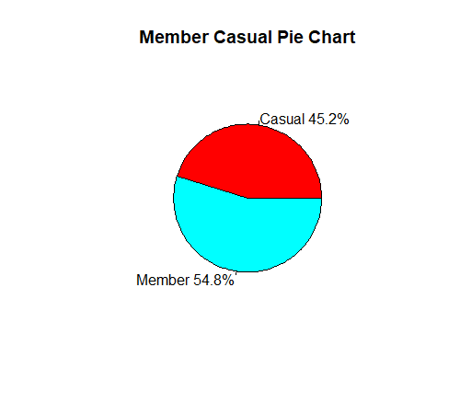
Number of Rides
Key Takeaway:
Annual Members made the most trips in the year of 2021

Slide 9
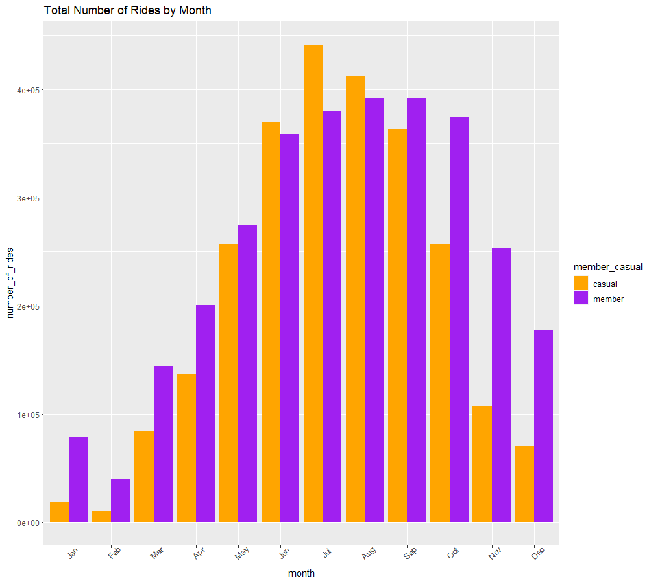
Number of Rides
Key Takeaway:
The busiest months for both riders were during mid-year.
Casual riders overtook annual members on June, July, and August 2021
Further analysis:
Is there any influences from Covid-19
If the pattern is consistent with other years
If temperature/ season affected the number of rides of both riders

Slide 10
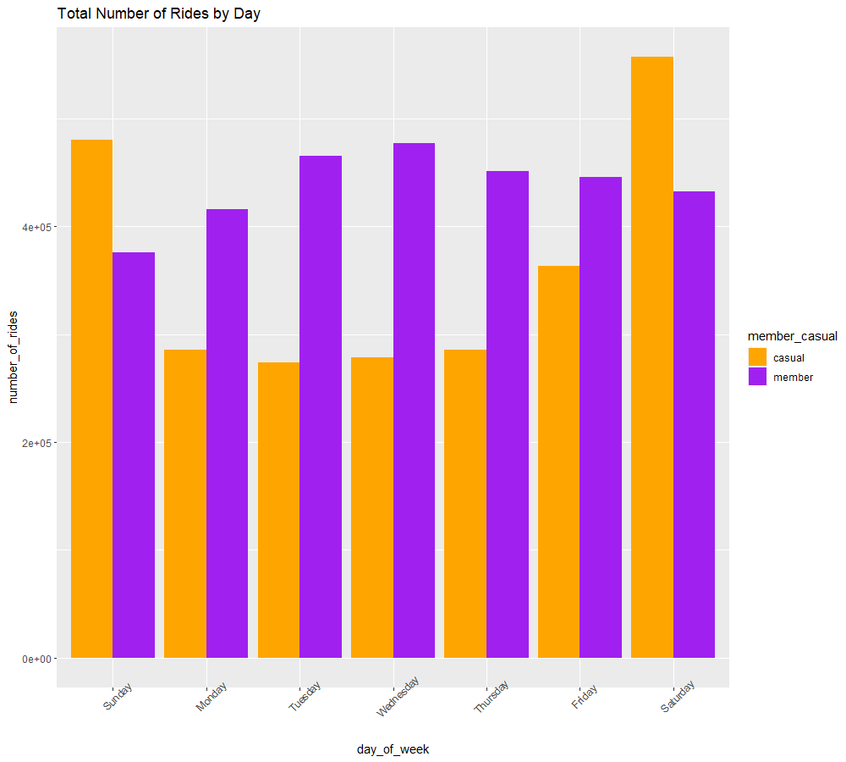
Number of Rides
Key Takeaway:
Trips made by Annual members are higher than Casual Riders on weekdays
Casual riders cycled mostly on Saturday and Sunday

Slide 11
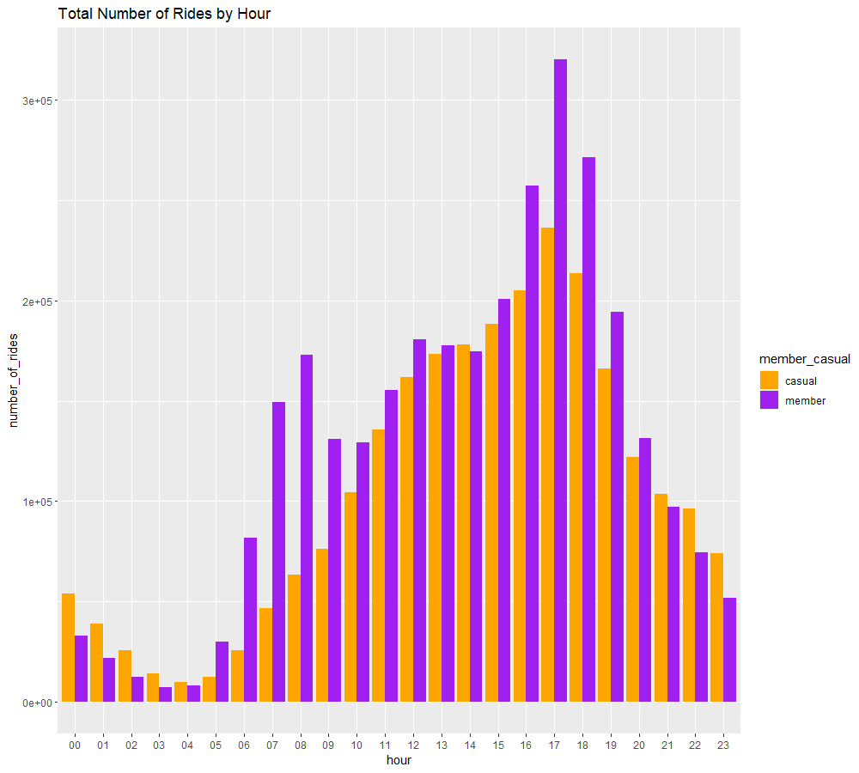
Number of Rides
Key Takeaway:
The peak times of rides were during:
>100.000 → 07.00 – 09.00 am
>200.000 → 04.00 – 06.00 pm
Casuals use the bikes more than Members after 09.00 pm (until around 04.00 am).

Slide 12
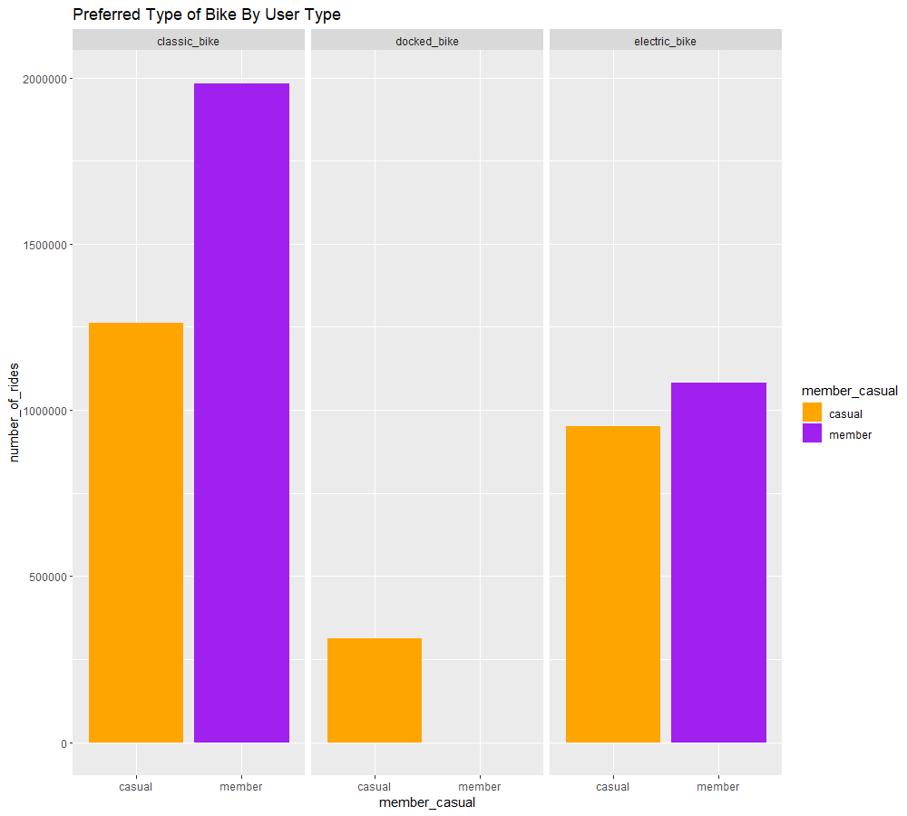
Bike Types
Key Takeaway:
Classic bike were the most used, followed by electric bike and docked bike
There was no Annual Member using docked bike
Further analysis:
Docked bike technical problem

Slide 13
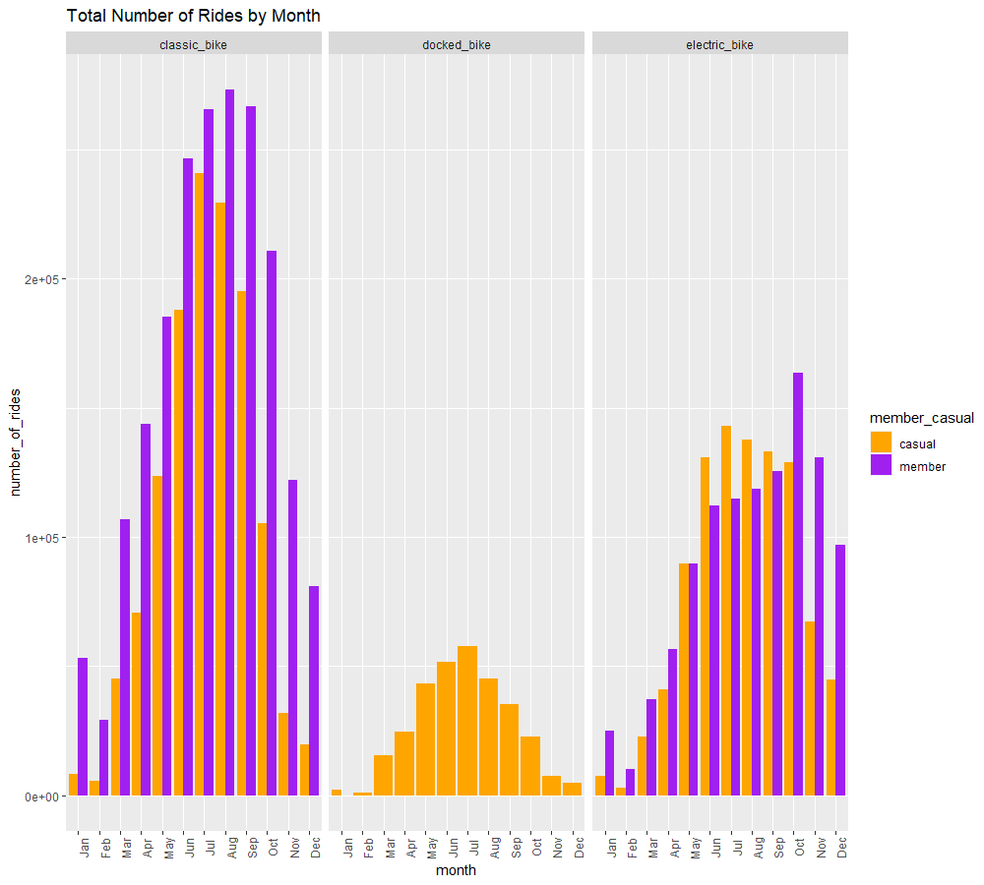
Bike Types
Key Takeaway:
Classic bike were the most popular among three bike types
There was no Annual Member using docked bike
Ebike casual users were outnumbered the annual members in 4 months: June, July, August, September
Further analysis:
Docked bike technical problem

Slide 14
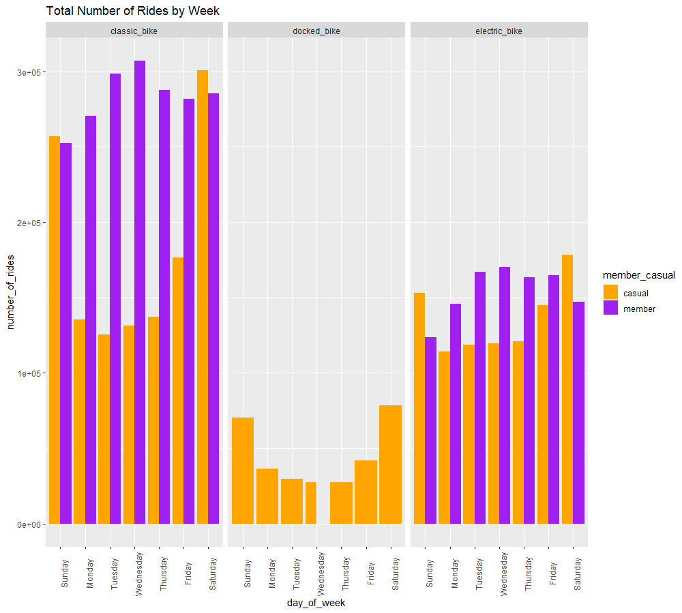
Bike Types
Key Takeaway:
Casual riders used classic and clectric bikes highly on weekend
Classic bikes were used by annual members consistently throughout the week
No members used docked bike
Further analysis:
Docked bike technical problem

Slide 15
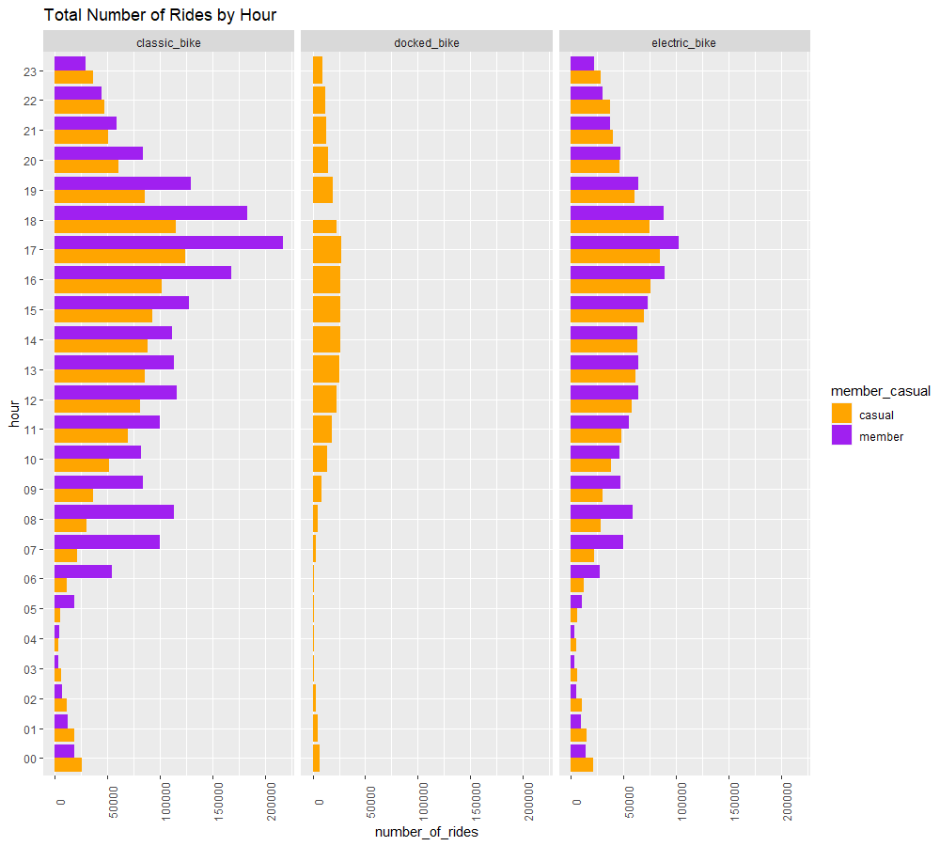
Bike Types
Key Takeaway:
Peak times for classic and electric bikers were during:
07.00-08.00 am
04.00-06.00 pm
No members used docked bike
Further analysis:
Docked bike technical problem

Slide 16
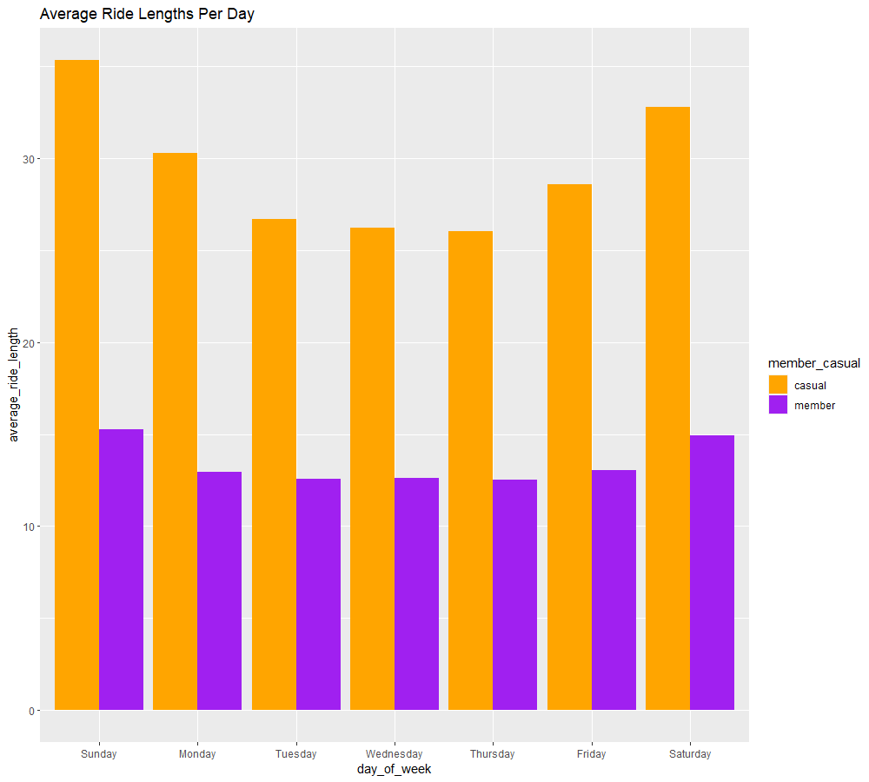
Ride Lengths
Key Takeaway:
Casual Riders had longer trip than members throughout the week
The average ride duration for member riders was consisteny almost throughout the week with Monday to Friday at ± 13 minutes with a slight increase to ±15 minutes over Saturday and Sunday
The average ride duration for casual rider was ± 27-30 minutes on weekdays, and >30 minutes on weekends

Slide 17
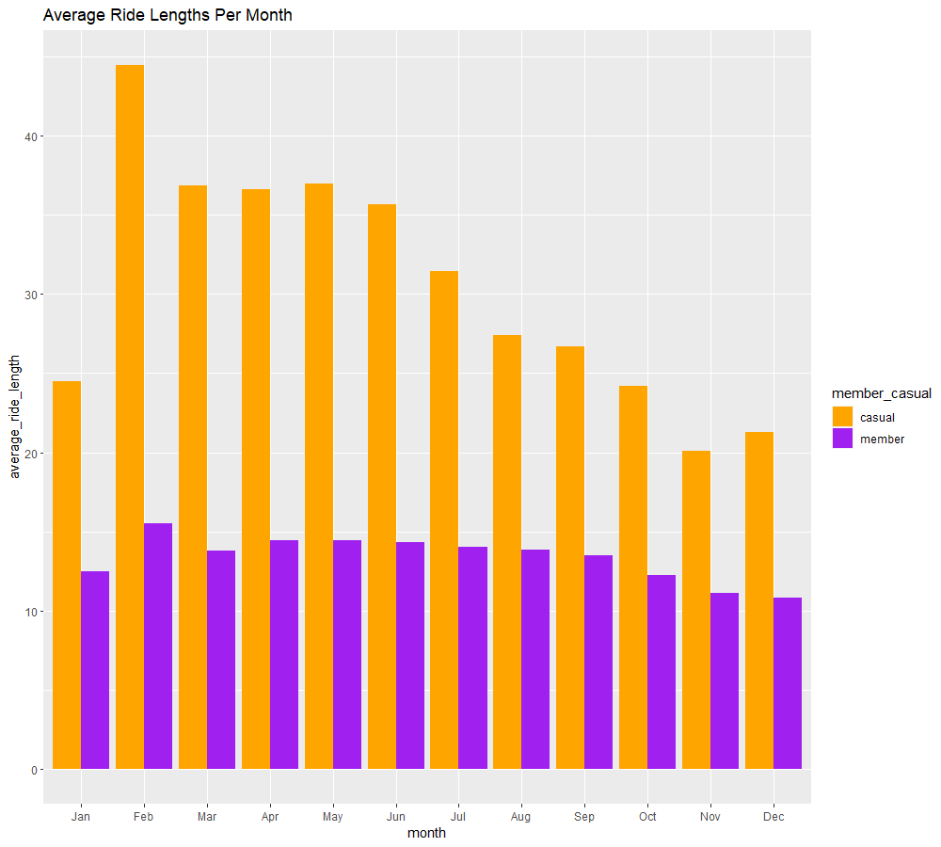
Ride Lengths
Key Takeaway:
Casual Riders had longer trip than members throughout the year
The average ride length for member riders was consistet in 2021, with ± 15 minutes every month
The average ride length for casual rider was fluctuative in 2021, with the highest average >40 minutes in Feb and the lowest 20 minutes in Nov

Slide 18
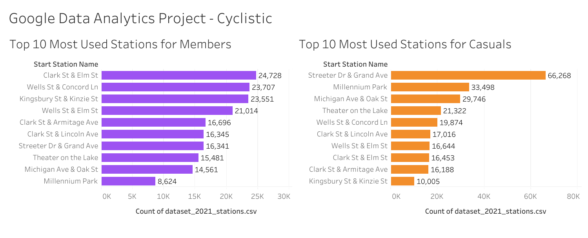
Most Popular Stations
Key Takeaway:
The most used stations for members in 2021 is Clark St & Elm St
The most used stations for casuals in 2021 is Streeter Dr & Grand Ave

Slide 19
5. Share
The share phase is done by presenting this powerpoint.
Some conclusions we can draw from the data:
In the period of 2021, members made trips more than casual riders
The peak season of the year was during June-September
The climax of the week was during weekend
The climax of the day was during 7-9 am and 4-6 pm
Both riders preferred Classic and Electric bikes over Docked bikes
Annual Members mainly used the Clark St & Elm St Station, while Casual Riders mostly used the Streeter Dr & Grand Ave station

Slide 20
6. Act
The act phase would be done by the marketing team of the company. The main takeaway will be the top three recommendations for the marketing:
1. Marketing team can design campaign focusing on the usage of bicycles regularly, by highlighting the environmental and health benefits, encourages people to download mobile apps to monitor their health, and provide reward system. Besides, providing coupons or discounts might increase riders in winter season.
2. Increase the number of classic bikes availability from June to September as the total number of rides were high during these months.
3. Production team can decide to launch more product of bicycles on top 10 stations during peak seasons : monthly (June – September), daily (weekend), hourly (4 – 6 pm)

Slide 21
The end
Thank you.

